Slide 1
Enhancing the development of Synergy within the group
Understanding synergy and how it affects patrol officers.
David A. Saldana, L20288642
Lamar University, Beaumont, TX.
Prepared for Criminal Justice Leadership 5345.

Slide 2

Lt. David A. Saldana 9164
Figure 1: CCPD badge (Corpus Christi Police Dept., 2019)
Hired January 8th 2007, with the Corpus Christi Police Department
AA in Criminal Justice; AAS in Police Science; AA in Liberal Arts from Del Mar College, 2010
Bachelor in Criminal Justice, Lamar University, 2018
Currently working on a Masters in Criminal Justice at Lamar University, (2019)
Field Training Officer (FTO) for two academy classes, and reserves.
Promoted to Lieutenant May 16th 2016
Currently assigned to Patrol Division in Delta District
TCOLE Instructor since 2010 and CCPD Academy Instructor.
Notes:
Talk briefly about myself, and credentials.

Slide 3
Introduction:
Enhancing the development of Synergy within the group.
Understanding synergy and how it affects patrol officers.
Notes:
Enhancing the development of Synergy within the group, and Understanding synergy and how it affects patrol officers.
As supervisors we know the importance of team work, or what we will be referring to as Team Synergy.
However, patrol officers tend to work alone, and our current system rewards that.
So, we need to look at strategies to encourage synergy on patrol shifts.

Slide 4
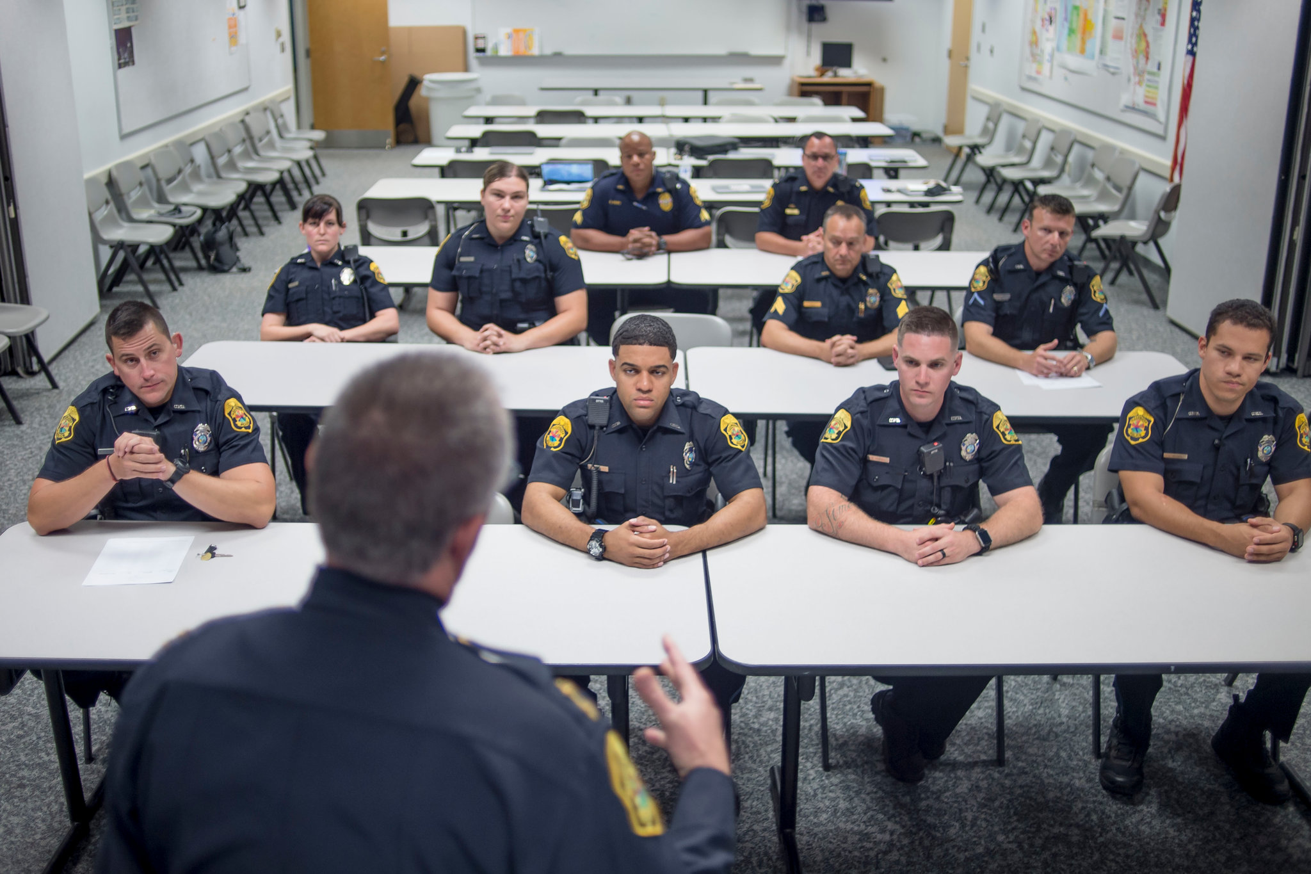
Definition:
“Synergy: The increased effectiveness that results when two or more people or businesses work together” (Kachgal, 2015, p. 10).
Figure 2: Roll call. (Wittman, 2018)
Notes:
The definition of Synergy is the increased effectiveness that results when two or more people or businesses work together.
A two man unit, who while one person is writing reports and completing paperwork. The other is driving to the next call, or looking for the next traffic stop is an example of team synergy.

Slide 5
Learning Objectives
Understanding Synergy, and how it affects patrol officers. Having a shared vision, values, and goals.
Understanding Negative Synergy, and how it affects patrol officers.
Getting officers to “buy” in. Good Leadership and followership.
Presentation: Application of Synergy on your shift. (see next slide)
Summary: Review of lessons learned/Points to remember, and Evaluations.
Notes:
Go over the objectives

Slide 6
Application of Synergy on your Shift
With your Index card, write down one goal that can be accomplished as a “team,” on your shift.
As the course progresses please write down your ideas, on how to accomplish that goal, and take notes.
Each student will present the goal, and how they will enhance synergy within their shifts to accomplish their goal and answer other students’ questions. Each presentation with Question and Answers will be limited to 5 minutes. (Objective 4)
Notes:
Have the class pull out their index cards.
Read from PPT.
Have everyone write down their responses and move through the class and have everyone introduce themselves, their experience, and what they wrote down.

Slide 7
Introduction:
In the academy we teach each cadet.
To think less of the individual.
To become part of this larger police family.
To back each other up, and be good partners.
Then when we think they are ready, we send them (new officers) out into the streets and encourage independent work.
Why do we discourage group work in policing?
Notes:
Go over this slide.
Call on 3-5 people to explain why in law enforcement we discourage group work in policing.
Ask 2-3 people to elaborate on those responses.

Slide 8
Understanding Synergy:
Building a Team Atmosphere
When building an effective team, there needs to be a strong leader who invests in the group, and who guides the team through the shift cycle (Matthews, & McLees, 2015).
As a first line supervisor YOU have the power to improve the working relationships of our subordinates. YOU have the ability to empower them to be better versions of themselves and to improve the quality of the work they give to the public by them working together towards common goals.
How Do YOU do this?
Notes:
Emphasize how the 1st line supervisor is the key to encouragement and team building.
Talk about positive influences you have had from supervisors that have carried you in your career and how that has encouraged you to be a team player.

Slide 9
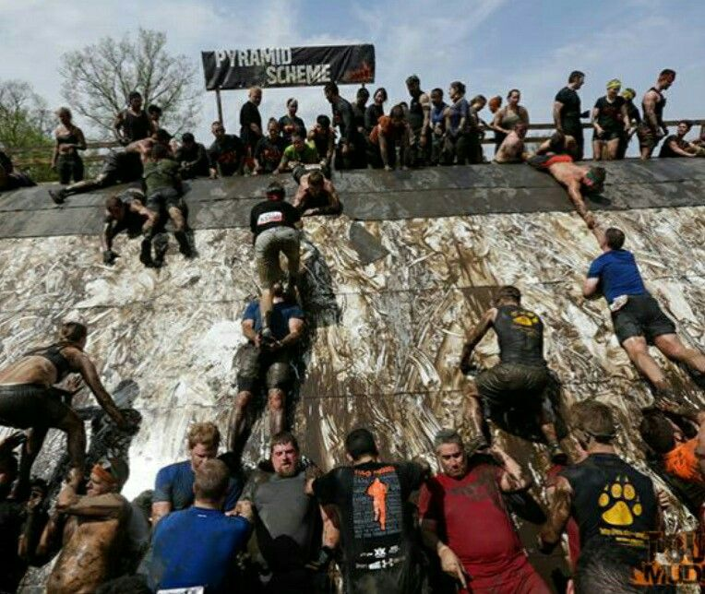
Understanding Synergy
Four Steps to Team Synergy
Set Goals and High Expectations. (Matthews, & McLees, 2015)
Hold people Accountable. (Matthews, & McLees, 2015)
Understand your people.
Fair and Regular Evaluations.
Figure 3: Tough Mudder team synergy, (Tough Mudder, 2014)
Notes:
Go over next slides, one at a time. Solicit responses.
Give work examples, of what has worked for you as a supervisor.

Slide 10
Understanding Synergy
Four Steps to Team Synergy
1. Set Goals and High Expectations. (Matthews, & McLees, 2015)
Patrol officers have a lot of discretionary time. This varies based on what shift or location in the city they work, and job proficiency.
However, setting reasonable but High expectations is important to encourage growth, and expand team building.
Be positive, have conviction and be confident this will inspire those on your team to stay on track even when something interferes (Matthews, & McLees, 2015).
Notes:
Go over next 2 slides, one at a time.

Slide 11
Understanding Synergy:
Setting Goals and Expectations.
Individual Officer Goals:
Making the Gang Unit.
A transfer to Narcotics.
Officer of the Month.
Improving their Driving While Intoxicated investigation proficiency.
Officer Safety skills
Emergency Driving proficiency.
Instructing at the Academy.
Completing a college degree.
Passing the Senior Officer Test or other promotional exam.
Shift Expectations:
All officers having 20 Traffic stops a month.
No Shift Preventable traffic accidents.
No citizen or internal complaints.
Meeting departmental goals.
All officers becoming crisis intervention certified.
Minimal use of force incidents.
All officers passing fitness standard.
Team before the individual.
Notes:
Step 1 slide 2, read from PPT and encourage participation.
Solicit responses.
Give work examples, of what has worked for you as a supervisor.
I’ve set goals for my shift as a team and for individuals. This has included that everyone on the shift obtain 20 traffic stops a month for the shift cycle and that the shift as a whole reduce residential burglaries in the Del Mar neighborhood.

Slide 12
Understanding Synergy
Four Steps to Team Synergy
2. Hold people Accountable. (Matthews, & McLees, 2015)
The department as a whole does a great job holding people accountable for failures that may draw media scrutiny or liability. However, where we can do better is holding officers and teams accountable at the day to day activities that shape an officers long-term career.
This does not mean that you need to micro manage, but that you need to take notice and steer the team towards their goals and expectations.
If being subtle does not work, then a more direct approach will be necessary.
* Regular feedback is necessary to attaining synergy and also for negative evaluations.
Notes:
Go over next slides, one at a time. Solicit responses.
Give work examples, of what has worked for you as a supervisor.
Holding people accountable, means sometimes you have to be the bad guy. You have to communicate to effectively lead and to encourage Synergy. What I do when someone is failing to meet expectations. I first try talking about the shift accomplishing their goals in shift roll call/briefing to encourage positive peer pressure. I try emails to the group, showing them where they currently are and where they need to be, with individual numbers shown. If that does not work, I move to the a 1 on 1 meeting in private, and follow up that with an email documenting the meeting. I discuss strategies for the officer to succeed and what the expectations are. I then slowly and progressively move on from there.

Slide 13
Understanding Synergy
Four Steps to Team Synergy
3. Understand your people.
It is important to understand exactly who you have on your shift. Team dynamic is set first by you but then by those who are on the team.
Some people are not good team players. (some excel on their own).
The disgruntled veteran. (been there done that, hates change and will tell others about what they think).
The ambitious rookie. (almost self-explanatory)
The “golden boy/girl.” (constantly gets awards and gets approval for things others don’t).
Dope hounds, citation writers. (usually solo players who have self-interest).
The perpetual back up officer. (is always there to help others take a report).
The computer genius. (Knows all the in and outs of department computer programs).
Notes:
Step 3, 2 Slides
Go over ppt.
one at a time. Solicit responses.

Slide 14
Understanding Synergy:
Four Steps to Team Synergy
Understanding your people, cont...
By the first line supervisor and the team (shift officers) understanding what everyone's strengths and weaknesses are. Including understand what everyone’s personal goals are. Allows for the chance for people to come together and be creative to problem solve and meet expectations.
John being a SWAT officer has excellent officer safety skills and Paul could use some tactical entry training. Lillian wants to make the Gang unit but does not have enough experience with gang members, and Amris works an area that has a heavy gang member presence and she knows their symbols, jargon, and people.
By building each officer individually you can meet goals and expectations through the team.
Notes:
Step 3, 2 Slides
Go over ppt.
one at a time. Solicit responses.
Give work examples, of what has worked for you as a supervisor.
You also have to understand your people, some people simply will not conform this may be because they have never been held accountable before, or they are on burn out. Maybe someone is working too much off duty or going through a divorce. Knowing your people and holding them accountable work hand in hand to get the best out of individuals and the team as a whole.

Slide 15
Understanding Synergy
Four Steps to Team Synergy
4. Fair and Regular Evaluations.
Evaluations are done twice a year in January and July, as per the CCPD General Rules Manual, 2019, and shift cycles typically parallel these periods.
On average, every six months your team changes it’s dynamic and you have to start over.
Therefore, it is important that each and every first line patrol supervisor evaluate their officers performance fair and regularly to help the subordinate.
Positive feedback can be given publicly, however negative feedback is always done in private (Matthews, & McLees, 2015).
Notes:
Final Step of the Four Steps, 2 Slides.
Read from PPT

Slide 16
Understanding Synergy:
Four Steps to Team Synergy
Fair and Regular Evaluations, cont...
How this helps Synergy
Evaluations or Performance management, is how the department sets goals, establishes the baseline standard, feedback on past performance, identifies training needs and recognizes good work (Lidinska, & Jablonsky, 2018).
This is where a subordinate can understand what is expected out of them and how they can maximize their evaluation (Lidinska, & Jablonsky, 2018).
All Employees especially millennial aged subordinates, want and need consistent and regular feedback. (Lidinska, & Jablonsky, 2018).
By evaluating subordinates not only on individual goals but on the completion of team expectations, it encourages them to work with other officers to reach their own potential.
It is important that this is not confused with rewards and awards.
Notes:
Read from PPT.
Emphasis on the importance of accountability and fair evaluations.
When the shift cycle is over and shift pick comes around. I take a great deal of time to write fair and accurate evaluation. I then forward these evaluations to their next supervisor so that they are aware, and can continue to hold the individuals accountable. We have all experiences the cherry picking of supervisors at shift picks.
Solicit responses from class.

Slide 17

Figure 4: Take a break, (Jose, 2017)
Notes:
Take a Break, check time, 10-15 minutes.

Slide 18
Objective 2:
Understanding Negative Synergy
Notes:
Understanding Negative Synergy, Objective 2

Slide 19

2. Understanding Negative Synergy
Negative Synergy can develop in a group. This is anything that is counterproductive to the team accomplishing goals and expectations.
Figure 5: Teamwork matters, (Labor Solutions AU, 2015)
Notes:
Go over the PPT slide and ask them to think about negative synergies.

Slide 20
Understanding Negative Synergy
Examples of Negative Synergies:
A negative officer who frequently expresses undesirable comments or behaviors.
Discontent with the organization/department.
The team being, Resistant to change.
Not enough information for the team to build on.
Too many “chiefs”, and not enough team players.
One or more people “sand bagging,” and allowing the others to do the work.
One or more people drawing from the others to seek individual wants/goals before the team.
Notes:
Go over the PPT slide
Ask for a few more thoughts of negative synergies.

Slide 21
Negative Synergy is detrimental to successful Team building
Effects of Negative Synergies:
Brings down the overall morale of those involved. And fuels frustration and lack of respect.
It is hard for members to “buy in” if they feel the organization is “out to get them.”
Synergy requires flexibility, being open to others thoughts and ideas.
If the direction is not clear, precious time is lost trying to find the way.
There is a time for each person to lead, but too many leaders can cause strife and harm the team.
Laziness and loafing have to be dealt with quickly so that those who are putting in the effort see that you stand behind them.
Self-interests that take from the success of everyone as a whole are selfish and contradictory to team building.
Notes:
Go over power points.
Go over the negative Synergy experienced on “J” Shift.
Officer, “Salinas,” called in sick every Sunday that the Cowboys were playing.
Caused other officers to purposefully take Sunday’s off as to avoid working short handed.
More senior officers grumbled loudly about him taking off, causing conflict with him.
Officer “Salinas,” would not meet shift or personal expectations, and would only work on projects that he deemed were important.
Continued escalating the conflict with the shift, causing him to be abrasive and often withdrawn.
Counseling sessions turned into denials and accusations that I was unfairly targeting him despite multiple warnings.
Come to find out that he had received average to good evaluations for low work performance, because he occasionally brought in excellent work on his pet projects that got him officer of the month awards on occasion. Other officers could not work on individual pursuits because they were picking up the slack and meeting team goals.
He basically struck out 8 of every 10 at bats, makes it to base once, and hits one game winning home run.

Slide 22
Some Negative Synergy is unavoidable
Being cognizant that some Negative Synergy is unavoidable and likely to continue, is important.
Team members (officers) have many stressors, that have to be taken into consideration. Such as but not limited to:
Critical Events, (deaths, shootings, assaults)
Post-Traumatic Stress Disorder (PTSD). As per Oehme, Donnelly and Martin (2012), PTSD in officers’ is reported as high as 8-17%, whereas the general population is at about 3.5%.
Depression, Anger management issues.
Family Issues, (divorce, separation, child custody).
Too much overtime or off duty work.
Alcoholism.
Notes:
Go over Slide
refer back to Step 3 of building Team Synergy, Knowing your people.
Trying to get down to the root of bad synergies may reveal personal issues that you can help with.
One of the best ways to reverse a negative person who is creating bad synergy is to help them through their problems and letting them know they are not alone in their struggles.
But be careful, some are very private and may take offense to it.
It is your job as a supervisor to broach these subjects delicately.

Slide 23
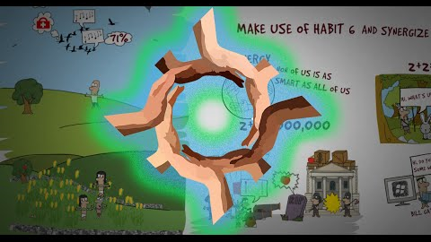
HABIT 6 - SYNERGY
Synergy and Negative Synergy Explained
MinionNoMore. (2016, JUL 16). Habit 6 – synergy. Retrieved from https://youtu.be/GAnJeey-6_Y
Notes:
Watch Video,
Discuss how other supervisors (the class) have worked on Negative Synergy and elicited more Team Synergy.
What are some ways we as 1st line supervisors can discourage negative synergy?

Slide 24
Objective 3:
Getting Officers to Buy in
Notes:
Getting officer to buy in is Objective 3

Slide 25
3. Getting officers to Buy in.
One of the most difficult things a 1st line police supervisor will do, is getting patrol officers who work independently to work as a cohesive team.
Patrol officers make life changing decisions every day, that affect themselves and the citizens they serve.
A perceived sign of weakness is an officer who prefers to work as a 2-man unit, to officers who prefer to ride solo.
Notes:
Go over the PPT slide
elicit responses on what prevents Team Synergy in officers and getting them to buy in.
And what do they believe we can do to change this culture?

Slide 26
Getting officers to Buy in.
Five Steps to get officers to buy into working as a team.
SHARE the vision you have with them, and tell them what the ultimate plan is.
LISTEN and solicit subordinate ideas on how to make them come to fruition.
INCORPORATE those ideas where you can. Remember there is more than one way to do it.
COMPARE their efforts to others.
LEAD by example.
Notes:
Go over the 5 steps to getting officers to Buy in.

Slide 27
Getting officers to Buy in:
SHARE:
A clear vision of what the expectations are and what the plan is, establishes a sense of focus for subordinates (Vveinhardt, J. & Banikonyte, J. (2017).
By eliminating confusion, a clear path can be developed, confidence in leadership is established, and the team can focus on the goals.
Example: During this next shift cycle, I want you all to demonstrate that you have matured, our goals are to minimize kickbacks on reports, have no at fault city vehicle accidents, and work together to solve the burglaries in the district.
Notes:
Read from PPT.
Example: During this next shift cycle, I want you all to demonstrate that you have matured, our goals are to minimize kickbacks on reports, have no at fault city vehicle accidents, and work together to solve the burglaries in the district.
What are some ways you can encourage to officers to buy in by sharing

Slide 28
Getting officers to Buy in:
LISTEN:
Performance and group synergy is increased when managers acknowledge group members perceptions and ideas (Vveinhardt, J. & Banikonyte, J. (2017).
This makes them feel important, relevant, and that they can make a difference.
Example: Officers suggest that too much of their time is spent on reports on Friday and Saturday nights to focus on the burglary issue, and that having access to Under Cover (UC) cars would be helpful.
Notes:
Read from PPT.
Example: Officers suggest that too much of their time is spent on reports on Friday and Saturday nights to focus on the burglary issue, and that having access to Under Cover (UC) cars would be helpful.
What are some ways you can encourage to officers to buy in by listening?

Slide 29
Getting officers to Buy in:
INCORPORATE:
When supervisors implement ideas from their subordinates, a sense of ownership is instilled which has proven to increase morale and work productivity (Vveinhardt, J. & Banikonyte, J. (2017).
This gives a sense of pride in the final outcome of their combined work.
Example: Arrange for a UC vehicle to be available and require all reports to be completed by the Sunday to Monday AM instead of nightly, since office personnel will not be in on the weekend anyways.
Notes:
Read from PPT.
Example: Arrange for a UC vehicle to be available and require all reports to be completed by the Sunday to Monday AM instead of nightly, since office personnel will not be in on the weekend anyways.
What are some ways you can encourage to officers to buy in by incorporating?

Slide 30
Getting officers to Buy in:
COMPARE:
When teams see quality work being produced by other groups it stimulates positive competition and innovation (Vveinhardt, J. & Banikonyte, J. (2017).
By comparing work from group to group, team members come to an understanding to succeed they must work together.
Example: The officers on your team after learning of the success of another shift, research what they are doing and come up with new ideas to improve.
Notes:
Read from PPT.
Example: The officers on your team after learning of the success of another shift, research what they are doing and come up with new ideas to improve.
What are some ways you can encourage to officers to buy in by comparing?

Slide 31
Getting officers to Buy in:
LEAD:
When a manager has confidence, is positive, and open, their increased participation stimulates the initiative of subordinates (Vveinhardt, J. & Banikonyte, J. (2017).
A favorable psychological climate sets the tone (Vveinhardt, J. & Banikonyte, J. (2017).
Example: You yourself take dispatched calls to free up manpower to utilize the UC vehicle, instead of calling for an officer to take a report, you take it yourself. When officers mention that they have hit a road block, remain positive and encourage them to look for another avenue.
Notes:
Read from PPT.
Example: You yourself take dispatched calls to free up manpower to utilize the UC vehicle, instead of calling for an officer to take a report, you take it yourself. When officers mention that they have hit a road block, remain positive and encourage them to look for another avenue.
What are some ways you can encourage to officers to buy in by leading?

Slide 32
Getting Officers to Buy in.
Discourage Negative Synergy
Remember:
Let team members know that you care about the project/or expectations that they are working on.
Offer strategies to succeed.
Keep a positive outlook about departmental policies and the overall culture.
Take time to listen to suggestions, and implement those that you can, if it will help them achieve their goals.
Invest in your subordinates, train your successor; offer and encourage them to seek training opportunities and to reach educational and career goals.
Notes:
Discouraging negative synergies.
Elicit responses from class, read from PPT as necessary.

Slide 33
Getting Officers to Buy in.
Discourage Negative Synergy
Remember:
Intercept upper administration and shield your subordinates from departmental interferences. Protect them when they are right and correct them when they are wrong.
Listen (eyes and ears) for outside negative synergies such as stressors from home, and try to help your subordinates along to make the right decisions.
Remember to always find positives when there are few, come evaluation time. Your work today may make a better team member tomorrow when they feel that someone cares.
Most of all LEAD by EXAMPLE.
Notes:
Discouraging negative synergies.
Elicit responses from class, read from PPT as necessary.

Slide 34
Objective 4:
Presentations:
Application of Synergy on your Shift
Notes:
Application of Synergy on your own shifts. Objective 4.
This is the presentations, let everyone know that there is a break coming and then give instructions on next slide.

Slide 35
4. Presentation:
Application of Synergy on your shift.
Each Student will present to class their “goal,” that they wrote down on the index card.
Give at least 5 ways that you as a first line supervisor will attempt to enhance synergy on your shift to accomplish those goals.
Each student will answer questions pertaining to their presentation.
The goal of the questions is to offer thoughts and/or present complications for the student to problem solve.
Presentations will be kept to 5-10 minutes each (due to time constraints).
Notes:
Read Objective 4, Presentation instructions.
Proceed to break.

Slide 36
Figure 4: Take a break, (Jose, 2017)
Notes:
Take a Break, check time, 10-15 minutes.

Slide 37
Objective 5:
Summary:
Review of lessons learned/Points to remember
Notes:
Remind students that the class is coming to its conclusion and that there is a student evaluation/test.
Objective 5 is,
Reviewing the lessons and what we have learned.
And Points to remember.

Slide 38
5. Summary:
Review of lessons learned/Points to remember
Definition of Synergy
Obtaining Team Synergy: 4 Steps
Understanding Negative Synergy
Getting officers to buy in: 5 Steps
Maintaining positive synergies
Sharing in rewards
Notes:
In the summary we will be going over these key points.
Read from PPT.

Slide 39
Definition:
“Synergy: The increased effectiveness that results when two or more people or businesses work together” (Kachgal, 2015, p. 10).
Figure 2: Roll call. (Zack Wittman, 2018)
Notes:
The definition of Synergy, is the increased effectiveness that results when two or more people or businesses work together.

Slide 40
Obtaining Team Synergy
Four Steps to Team Synergy
Set Goals and High Expectations. (Matthews, & McLees, 2015)
Hold people Accountable. (Matthews, & McLees, 2015)
Understand your people.
Fair and Regular Evaluations.
Figure 3: Tough Mudder team synergy, (Tough Mudder, 2014)
Notes:
Obtaining Team Synergy
Going over the Four Steps to Team Synergy.
Set Goals and High Expectations.
Hold people Accountable.
Understand your people.
Fair and Regular Evaluations.

Slide 41
Understanding Negative Synergy
Negative Synergy can develop in a group. This is anything that is counterproductive to the team accomplishing goals and expectations.
Figure 5: Teamwork matters, (Labor Solutions AU, 2015)
Notes:
Understanding Negative Synergy.
Negative Synergy can develop in a group. This is anything that is counterproductive to the team accomplishing goals and expectations.

Slide 42
Getting officers to Buy in.
Five Steps to get officers to buy into working as a team.
SHARE the vision you have with them, and tell them what the ultimate plan is.
LISTEN and solicit subordinate ideas on how to make them come to fruition.
INCORPORATE those ideas where you can. Remember there is more than one way to do it.
COMPARE their efforts to others.
LEAD by example.
Notes:
The Five steps to getting officers to Buy in.
SHARE --------------the vision you have with them, and tell them what the ultimate plan is.
LISTEN --------------and solicit subordinate ideas on how to make them come to fruition.
INCORPORATE -----those ideas where you can. Remember there is more than one way to do it.
COMPARE ----------their efforts to others.
LEAD ----------------by example.

Slide 43
Maintaining Positive Synergies
What many 1st line police supervisors will encounter is when they have finally achieve a solid cohesive group of officers that have excellent synergy, the inevitable will occur.
Shift change, new officers will move to your shift and some will move on. This can cause negative synergy.
This period is critical for you to stay positive, express goals and set forth expectations of performance.
Speak of the success and failures of the previous shift and start the process of moving forward.
A confident leader, inspires confidence (Vveinhardt, J. & Banikonyte, J. (2017).
Encourage any officers who remained to lead the way and inspire the group as a whole.
Notes:
Maintaining Positive Synergies
Go over PPT and encourage participation.

Slide 44
Sharing in Rewards
When success comes, it is important that both the individual and the group is recognized. Even a reward that you may earn as a first line supervisor.
When an officer receives an award and it is presented, make sure to express that they did a great job to the group as a whole.
Example: An officer tracks down multiple felony warrants in a month and had a large drug seizure on a traffic stop. And receives an Officer of the Month Award.
Mention (If appropriate) that the groups work, may have helped make it happen.
Example: For those of you that backed up “Garcia,” and helped him on his call load so that he had the time to work on this, thank you. You are part of what made this happen.
As a supervisor any positive feedback your shift receives and/or you for the way they are performing, should be passed on. You are only as great as the team you have inspired.
Notes:
Sharing in Rewards.
Positive reinforcement and growing the team.
Go over the PPT.

Slide 45
References
Corpus Christi Police Department. (2019). CCPD badge [Image file]. Retrieved from https://stopdrugscorpuschristi.org/default.aspx?MenuItemID=865&MenuGroup=Public+Corpus+Christi
Jose, J. (2017). Take a break [Image file]. Retrieved from http://angelsandsuperheroes.com/2017/07/03/take-a-break/
Kachgal, J. (2015) The synergy needed for business resilience. Journal of Business Continuity & Emergency Planning, 9(1). 10-17. Accession No. 110394504
Tough Mudder, (2014). Tough Mudder team synergy [Image file]. Retrieved from http://2.bp.blogspot.com/-au5TCWPeky8/VCAvFuoQLyI/AAAAAAAAAmk/11g0UMUMXbQ/s1600/tough-mudder_pyramid-scheme_human-pyramid-climb_pull-ups_large-group-teamwork.jpg
Labor Solutions AU. (2015). Teamwork matters [Image file]. Retrieved from https://www.laboursolutions.com.au/blog/2015/09/30/4-reasons-why-teamwork-matters/
Lidinska, L., & Jablonsky, J. (2018).4545 AHP model for performance evaluation of employees in a Czech management consulting company. Central European Journal of Operations Research, 26(1). 239-258. Accession No. 127378619
Notes:
Reference Slide,
Pass out Student Evaluations and Instructor Evaluations.

Slide 46
Matthews, R., & McLees, J. (2015). Building effective projects teams and teamwork. Journal of Information Technology & Economic Development, 6(2). 20-30. Accession No. 112466627
MinionNoMore. (2016, JUL 16). Habit 6 – synergy [Video]. Retrieved from https://youtu.be/GAnJeey-6_Y
Oehme, K., Donnelly, E., & Martin, A. (2012). Alcohol abuse, ptsd, and officer-committed domestic violence. Policing: A Journal of Policy & Practice, 6(4), 418-430. Accession No. 83331209
Vveinhardt, J. & Banikonyte, J. (2017). Managerial solutions that increase the effect of group synergy and reduce social loafing. Management of Organizations: Systematic Research, 78(1). 109-129. Accession No. 127819912
Wittman, Z. (2018). Roll call [Image file). Retrieved from https://www.nytimes.com/2018/07/15/nyregion/bias-training-police.html
Notes:
Reference Slide,
Pass out Student Evaluations and Instructor Evaluations.

Slide 47
End of Course
Evaluations
Notes:
End of Course, Complete evaluations.

